Slide 1
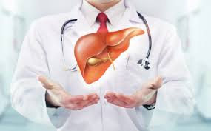
Liver Enzymes
By
Dr. Hussein Al Naji

Slide 2
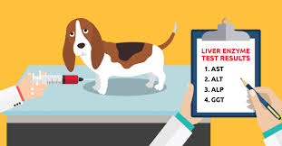
Liver dysfunction
Liver failure or hepatic insufficiency is the inability of the liver to perform its normal synthetic and metabolic function as part of normal physiology. Two forms are recognised, acute and chronic.
The major hepatic functions that, when disordered, are responsible for clinical signs include:

Slide 3
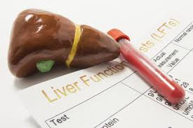
The maintenance of normal bloodglucose levels by providing the source as glycogen
The formation of some of the plasma proteins
The formation and excretion of bile salts and the excretion of bile pigments
The formation of prothrombin
The detoxification and excretion of many toxic substances, including photodynamic agents

Slide 4
SERUM HEPATIC ENZYM ES
The determination of serum levels of hepatic enzymes is used commonly for the detection and evaluation of hepatic disease.
Sorbitol dehydrogenase (also called L-iditol dehydrogenase (ID) :
it is almost completely selective as an indicator of acute hepatocellular damage and is the preferred test for hepatic damage in sheep and cattle and horse but the SDH is a very labile enzyme and should be assayed within a few hours of samples collection.

Slide 5
*Lactate dehydrogenase (LDH)
It is abundant in liver, kidney, muscle and myocardium, its tetramer du to large size and long half life LDH activity remains raised for some time after the damage.
*Aspartate aminotransferase orvL-alanine aminotransferase (ALT, previously known as SGPT)
are of some value as an indicator of liver damage because of their high content in liver but are generally considered to be too nonspecific to be of great diagnostic value. In small animals found in skeletal muscle, cardiac muscle, liver and erythrocytes.

Slide 6
Gamma-glutamyl transferase
is an enzyme widely distributed in a variety of equine tissues. Specific activity of GGT in the horse is highest in the kidney, pancreas and liver. Serum GGT activity is used as a diagnostic criterion for hepatobiliary diseases in cattle, sheep and horses. In the horse, increases in serum GGT may be associated with hepatocellular damage and liver necrosis

Slide 7
*Glutamate dehydrogenase (GD)
occurs in high concentration in the serum of ruminants and horses with liver disease, its less labile than SDH and therefore the test of choice in the horse
*Alkaline phosphatase
It levels are used as a test of hepatic excretory function in the horse and are of value in that species but variations in normal cattle have such a wide range that results are difficult to interpret. Of the tests available for testing of biliary obstruction the serum ALP test is preferred. However, there is a similar response to damage in other tissues.

